Slide 1
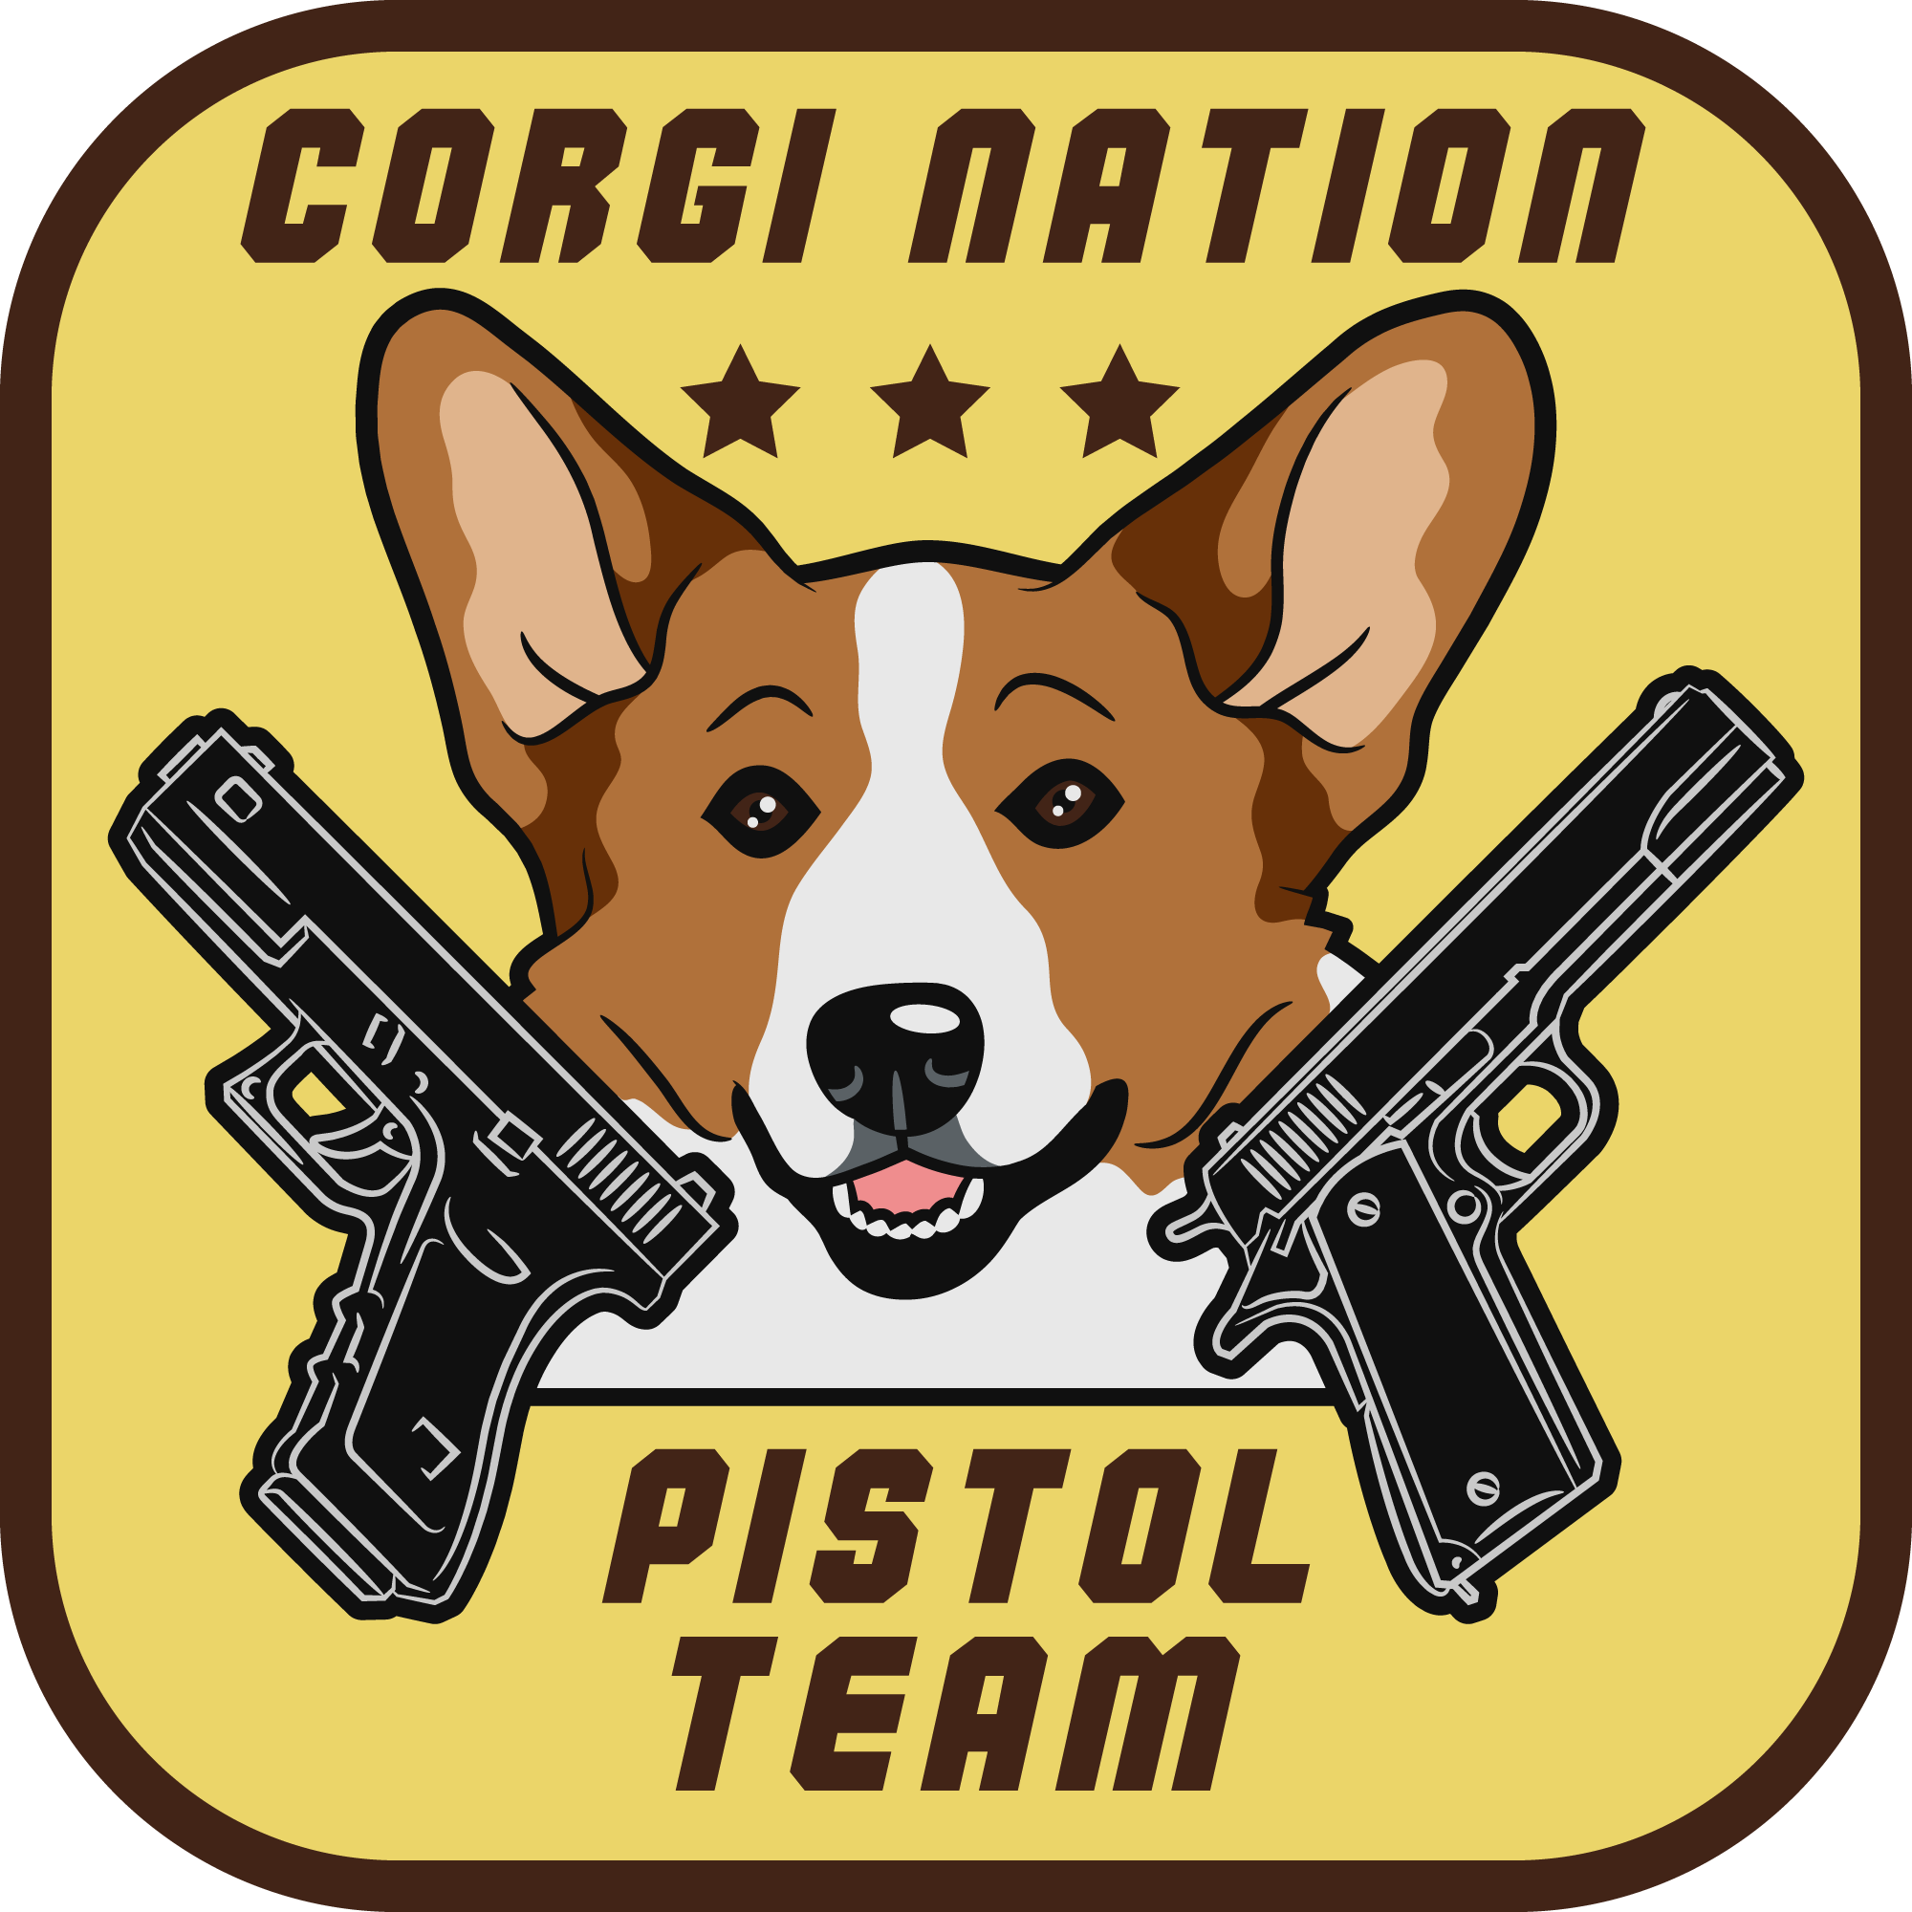

 | Renton Fish & Game Old McDonald Had a Farm in a Bad Neighborhood Stage 2: Scarecrow Standards Course Designer: Corgi Nation Pistol Team
SCENARIO: This is a Standards Stage. If it were a scenario stage the scenario would be: After finishing up harvesting the corn crop an angry mob of Scarecrows have come to life and are out for revenge! Save your hide and ears!
START POSITION: Firearm loaded to 6 rounds only. Standing squarely facing the wall at P1, hands relaxed at sides. PCC stock on belt, muzzle pointed squarely downrange. |  | STRINGS: 1 SCORING: Unlimited SCORED HITS: Best 2 ROUND COUNT: 12 TARGETS: 6 IDPA, 2 NT, START-STOP: Audible - Last shot CONCEALMENT: Required Muzzle Safe Points: 180 degree rule SO NOTES: Targets staggered from 3 yds min to 10 yds max. T-1 and 6 are headshots only. T3 and 4 are shoulder and head.
STAGE PROCEDURE: At start signal, engage all targets with 2 shots behind the cover of P1.
T 3
T4
T2
T5
T1
T6
P1

